Slide 1



Website Kick-Off
Presentation

Slide 2
Our Goals
The aim of the project is a comprehensive update of the ACME environments in order to:
promote the ACME brand and markets
promote the ACME services
provide the customers a logical setting where they will find relevant information about ACME
provide market data on the ACME environment (tables and interactive charts)
establish modern technical standards (e.g. using responsive design, integrating social media channels, using a content management system)
It will allow a much-needed harmonisation of the websites and the concentration of the relevant information
The ACME environments will cater to the different needs of the relevant target groups
🡪 ACME website serve different target groups.

Slide 3
Target Groups
Regulators and other institutional bodies
Customers of other services (guarantees of origin, white certificates and upcoming activities)
Press/media
Job seekers
Other interested parties (consultants, etc.)
Internal users (staff, management, board members, shareholders, etc.)
ACME members and prospects: data and specifications are helpful to both font and back offices as they are used them for system setup and information
Regulators and other institutional bodies: data, specifications and general information are used to highlight the transparency of our markets
Press/media: data, specifications and general information are used to highlight the transparency of our markets
Other interested parties (consultants, etc.): information is mainly used in the context of different projects
Internal users (staff, management, board members, shareholders, etc.): market data is mainly used

Slide 4
Projected Milestones
Decision on hosting and provider
Website Go-live
Jul
Aug
Sep
Oct
Nov
Dec
Jan
Feb
Mar
Apr
Concept
Market data configuration, content publication
Market data depiction
Requirement specifications
Pitches
Functional specs
Implementation phase
Testing
Design ACME specs with provider

Slide 5
Discussion

Slide 6
Background Information

Slide 7
Exchange Trading 1/2
Exchange Trading offers:
standardised products
standardised trading & settlement processes
regulated transparent market
reference prices to the market
securities (e.g. against default risks)
anonymity of the involved counterparties
Spot Market:
short term market – e.g. today and tomorrow
Derivatives Market:
Trading transactions concluded on the Derivatives Market are settled physically and financially at a later time agreed in advance. Trading on the Derivatives Market permits portfolio optimization in the medium to long term.
offers futures, spreads
Hubs:
Term for market areas in natural gas trading

Slide 8
Exchange Trading 2/2
Futures:
A futures contract is the contractual obligation to buy (buyer of a future) or sell (seller of the future) a specified quantity of an underlying security at a specified price during a specified period (delivery period). Futures contracts are exclusively traded on regulated exchanges and settled on a daily basis at the current market price.
Settlement:
Settlement comprises the financial and physical fulfilment of a trade.
Settlement Price:
Daily market price of a future or option contract which is established by the exchange and used for its daily settlement.
Clearing House:
This is a body which steps into the process chain between the buyer and seller in the capacity of the central counterparty. The clearing house settles the transactions with the buyer and seller, carries out the delivery of transactions with these and collateralizes the transactions.
Clearing:
Clearing refers to the financial and physical settlement of transactions.

Slide 9
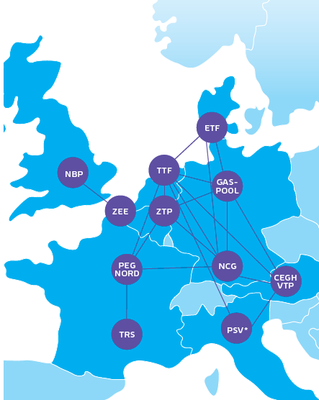
Natural Gas Trading 1/2
Hubs at ACME : GASPOOL, NBP, NCG, PEG NORD, PEG SUD, PEG TIGF, PSV, TTF, ZEE and ZTP
Products
Within-Day: enables the intraday arbitrage and balancing for the running gas day
Day-Ahead: enables to buy/sell gas for the next gas business day
Day: enables to buy/sell gas for an upcoming Bank Holiday, following the ACME trading calendar
Weekend, Saturday, Sunday contracts: enables to buy/sell gas for the coming week-end, Saturday, Sunday
Futures
Spreads
24/7 trading on the natural gas spot market
Trading in Future und Location Spreads: 8:00 am – 06:00 pm (MEZ)

Slide 10
Natural Gas Trading 2/2
Gas Delivery Day: from 6h to 6h
Gas Trading Day: from 3h to 3h
Gas Business Year:
from 1 October, 06:00:00, of one calendar year
to 1 October 05:59:59 of the following year
Gas Qualities: There are two qualities of natural gas: L (low) and H (high). Because of the higher methane concentration (87 - 99 % by volume) H-gas has a higher calorific value. L-gas, which is largely produced domestically, has higher nitrogen and carbon dioxide contents, while methane accounts for a share of 80 to 87 percent by volume.

Slide 11
ACME Target Groups
Regulators and other institutional bodies
Customers of other services
Press/media
Job seekers
Other interested parties (e.g. analysts, consultants)
Internal users (e.g. staff)
rules/regulations, admission forms
markets, GO data, energy savings Data
newsroom ACME, social network
newsroom ACME, social network
markets, GO data, energy savings Data
company information
list of services
rules/regulations, admission forms
list of services
specifications, connectivity, membership fees
company information
company information
specifications, connectivity, membership fees
specifications, connectivity, membership fees
list of services
newsroom
company information
company information
company information
list of services
list of services
newsroom ACME, social network
newsroom ACME, social network
newsroom ACME, social network
Green marked boxes show interests that concern uniquely ACME.

Slide 12
ACME Target Groups
Members & Prospects
Regulators and other institutional bodies
Analysts and consultants
Internal users (e.g. staff)
Press/media
market data tables
market data tables
market data tables
market data tables
brand information
market zones, participants, price references, brokers
market zones, participants, price references, brokers
market (zones), participants, price references, brokers
benefits, customer info, contact form
specifications, connectivity, membership, fees
market (zones), participants, price references, brokers
newsroom
specifications, connectivity, membership, fees
specifications, connectivity, membership, fees
information on brand
Violet marked boxes show interests that concern uniquely ACME.

